Slide 1
Diagnosing Hypertensive Crises in Elderly Patients
A Critical Approach
Navigating the complexities of acute hypertension in our aging population.
By
Dr sajjad hosseini
Cardiologist
Assistant professor of TUMS

Slide 2
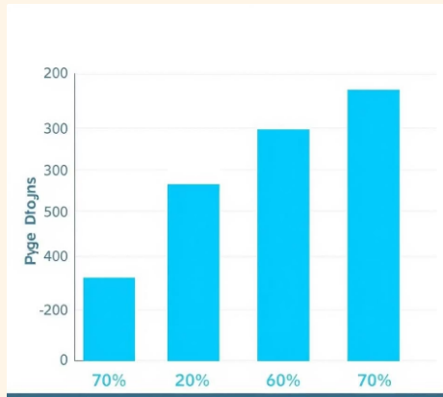
Hypertension in the Aging Population
The prevalence of arterial hypertension and its related complications, including hypertensive crises is constantly rising, mainly as the result of the aging of the population, in particular, the increase in the population over 80 years old.

Slide 3
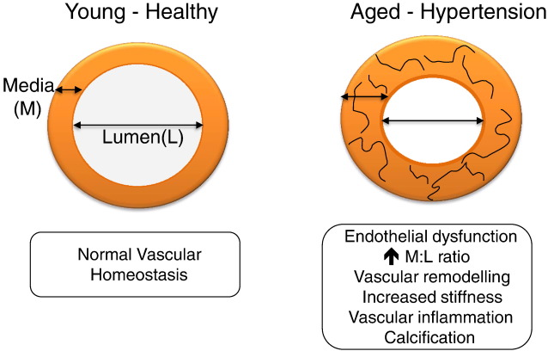
Changes in BP During the Aging Process: the
Role of Arterial Stiffness and Comorbidities
Arterial stiffness is the major cause of elevated systolic BP (SBP) and pulse pressure (PP, SBP minus diastolic BP [DBP]) as well as lower DBP in older adults.
BP age-related alterations are determinants of major cardiovascular disease (CVD) events and all-cause mortality.

Slide 4
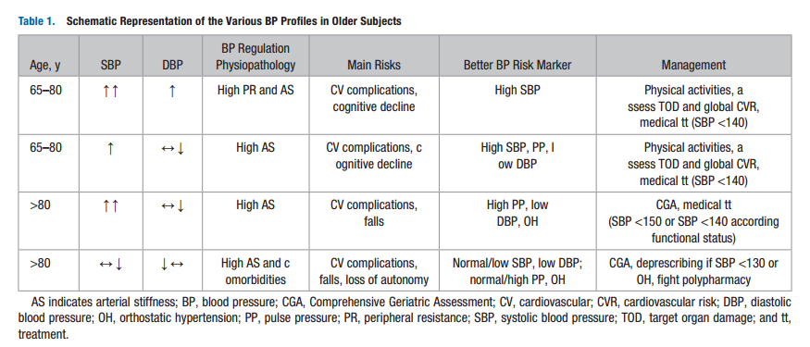

Slide 5
Impaired BP Homeostasis and Increased BP
Variability
Orthostatic hypotension : hypertension, chronic autonomic failure in the context of Parkinson disease and other neurological diseases, polyneuropathy mainly in the context of diabetes mellitus. dehydration and polypharmacy (especially in case of vasodilators, diuretics, and psychotropic medications).
BP variability : Arterial stiffness is also implicated in the increased variability in BP observed in several other conditions, such as exercise, postprandial BP variations (both increase and decrease in BP are exaggerated in individuals with pronounced arterial stiffness), and between-visit BP variability.

Slide 6
Specificities of the Clinical Evaluation in Older
Adults With Hypertension
Managing old patients is highly time-consuming because of several factors: complexity of the health condition , multiple comorbidities, physical and cognitive slowness of older people .
The diagnosis of hypertension should be based on at least 3 different BP measurements, taken on 2 separate office visits .
The rules of office BP measurements are the same as for younger individuals.
Secondary (potentially curable) hypertension : abrupt elevation of both SBP and DBP, a sudden deterioration of what was previously well-controlled hypertension, resistant hypertension, or clinical and biological indications suggestive of a particular form of secondary hypertension,
Medication-related BP elevation should always be investigated : nonsteroid anti-inflammatory drugs, nasal decongestants, corticosteroids, hormone replacement therapy, ephedrine-containing supplements.

Slide 7
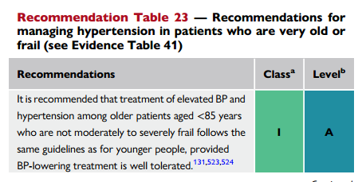
Guidelines for BP Goals and Therapeutic
Strategies in Older Patients With High BP

Slide 8
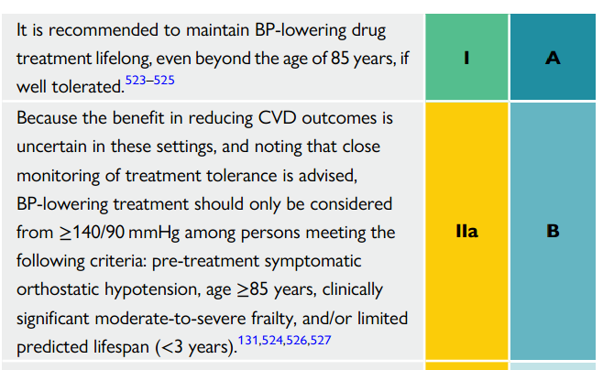

Slide 9
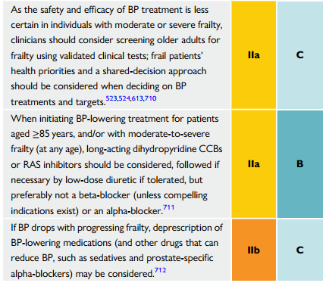

Slide 10


Slide 11
Understanding Hypertensive Crisis: Urgency vs. Emergency
Hypertensive Urgency
severe elevation in blood pressure (typically systolic BP >180 mmHg or diastolic BP >110 mmHg) without evidence of acute target organ damage. Oral medications are used for gradual reduction over 24-48 hours.
Hypertensive Emergency
Defined by severe blood pressure elevation with evidence of acute or progressing target organ damage (e.g., stroke, acute heart failure, renal failure, aortic dissection). Requires immediate, often intravenous, blood pressure reduction in an intensive care setting.

Slide 12
Why older adults are at higher risk?
Elderly patients often present with a complex medical history that significantly impacts the diagnosis and management of hypertensive crises.
Comorbidities: Conditions like chronic kidney disease, coronary artery disease, diabetes, and cerebrovascular disease are common. These can predispose to hypertensive crises and influence the choice of antihypertensive agents.
Polypharmacy: The use of multiple medications is common in older adults, increasing the risk of drug interactions, side effects, and adverse events. Some medications can also elevate blood pressure.
Atypical Presentations: Symptoms of target organ damage might be subtle or masked by other age-related conditions, making diagnosis challenging.
Fragility and Falls: Aggressive blood pressure reduction can lead to orthostatic hypotension, increasing the risk of falls and injury.
Understanding these factors is paramount for safe and effective care.

Slide 13
Recognizing the Red Flags: Symptoms and Signs in Older Adults
Prompt recognition of symptoms and signs of target organ damage is critical for identifying a hypertensive emergency. In older adults, these may be less obvious or attributed to other conditions.
Neurological
Severe headache, blurred vision, confusion, altered mental status, seizures, focal neurological deficits (e.g., weakness on one side).
Cardiovascular
Chest pain, shortness of breath, acute pulmonary edema, dissecting aortic aneurysm (sharp, tearing back pain), signs of acute heart failure.
Renal & Other
Acute kidney injury (e.g., decreased urine output), nausea, vomiting, epistaxis (nosebleeds), retinal hemorrhages or papilledema on fundoscopic exam.

Slide 14
Initial Assessment & Diagnostic Workup: What to Look For
A thorough and rapid assessment is paramount to determine the presence of target organ damage and guide management.
Vital Signs: Repeated blood pressure measurements in both arms, heart rate, respiratory rate, oxygen saturation.
Physical Examination: Neurological assessment (GCS, focal deficits), cardiovascular exam (heart sounds, murmurs, peripheral pulses), pulmonary exam (crackles, wheezes), abdominal exam, and fundoscopic exam for retinal changes.
Laboratory Tests:
  Complete blood count (CBC)
  Electrolytes, BUN, creatinine (renal function)
  Cardiac enzymes (troponin for cardiac ischemia)
  Urinalysis (hematuria, proteinuria)
Imaging: Chest X-ray (pulmonary edema, aortic dissection), ECG (ischemia, arrhythmias), head CT/MRI (stroke, ICH), depending on suspected organ involvement.

Slide 15
Acute Management Principles: Stabilizing the Elderly Patient
Target Organ Protection
Reduce BP gradually to protect vital organs. For most emergencies, aim for a 10-25% reduction in the first hour, then to 160/100 mmHg over the next 2-6 hours.
Medication Choice
IV agents (e.g., labetalol, nicardipine, esmolol) are preferred due to titratability. Choose based on suspected organ damage and patient comorbidities, avoiding agents that may worsen existing conditions.
Careful Monitoring
Continuous BP monitoring, neurological status, and urine output are essential. Adjust medication titration as needed based on patient response and tolerability.

Slide 16
Key Takeaways & Resources for Clinicians
Differentiate Urgency vs. Emergency
Accurate assessment of target organ damage is paramount.
Consider Elderly Specifics
Account for comorbidities, polypharmacy, and atypical presentations.
Gradual BP Reduction
Avoid aggressive drops to prevent hypoperfusion.
Focus on Long-Term Prevention
Optimize chronic BP control and holistic patient care.

Slide 17
Thanks for your attention

