Slide 1
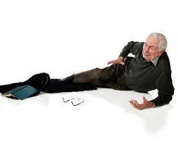
Fall 2023
Dr. Zhale Zandieh
Assistant Professor of Geriatric Medicine, MD,
Department of Gerontology,
University of Social Welfare and Rehabilitation Sciences, Tehran, Iran.
E-mail : zh.zandieh@uswr.ac.ir
Mob: +98-9188307064

Slide 2

Balance and Gait Impairments and Falling
Over one-third of community-dwelling persons over age 65 fall every year
functional and mobility decline
Three screening questions
initial visit and annually,
“Have you fallen and hurt yourself in the past year?”,
“Have you fallen two or more times in the past year?” (the best predictor of falls-related injury),
“Do you fear falling because of balance or gait?”
The Centers for Disease Control and Prevention’s 12-item Stay Independent Questionnaire (http://proptrehab.com/wp-content/uploads/2018/09/document9.pdf) is also a useful screening tool.

Slide 3
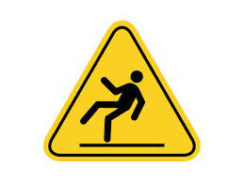
Balance and gait
Observing patients walking and performing balance maneuvers best assesses balance and gait disorders
ability to maintain a side-by-side, semi-tandem, and full-tandem stance for 10 seconds
resistance to a nudge
stability during a 360-degree turn
Quadriceps strength can be briefly assessed by observing an older person arising from a hard armless chair without the use of his or her hands
“up and go” test is a timed measure of the patients’ ability to rise arm chair, walk 3 m (10 ft), turn, walk back, and sit down again; those
who take longer than 20 seconds to complete the test should receive further evaluation
Gait speed is also a helpful marker for recurrent falls. Patients who take more than 13 seconds to walk 10 m are more likely to have recurrent falls

Slide 4

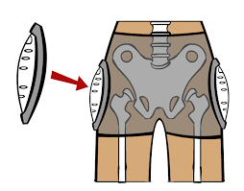

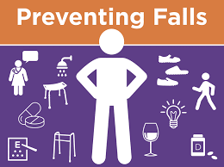
Fall or fear of fall
History( loc , palpitation, trauma, ..)
BP, OH
Assistive device
Visual acuity
Drugs (BNZ, Alcohol, anti depressant, ..)
Cog
Gait and balance
Neuromuscular sys
Tremor and rigidity
ECG, Holter
BMD
TREATMENT:
Exe, environmental, vit D, Ca, PT,OT, hip protection
Cardiovascular , neurologist

Slide 5
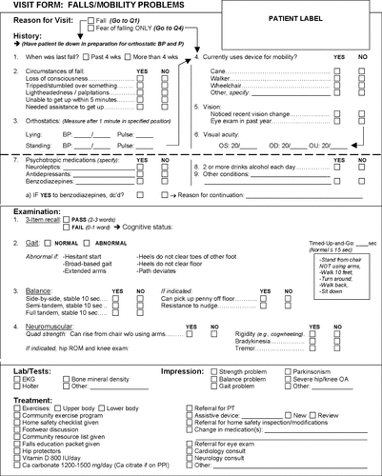

Slide 6


