Slide 1

fall in Older Adults Epidemiology & Burden of disease
Batool Mousavi, MD, MPH,
Community and preventive medicine
Janbazan Medical and Engineering Research Center (JMERC)
Day: 26- تیرماه -1404 (17-July-2025)
Time: 9:00-12:00

Slide 2

Older Adults and fall
Senior citizens=>60/65years
Now and future of aging
Fall definition
Fall epidemiology & prevalence
Fall burden of disease and aging
سالمندی
زمین خوردن
اهمیت و شیوع زمین خوردن و بار آن
آمارهای مرتبط با زمین خوردن در سالمندان، شیوع زمین خوردن در settingهای مختلف (جامعه،بیمارستان ها، مراکز نگهداری)
بار بیماری ها با محوریت سقوط

Slide 3



Elderly future
  The world is ageing rapidly. According to United Nations population projections:
  Between 1974 and 2024 (50yrs), the worldwide share of people aged 65 almost doubled – increasing from 5.5% per cent to 10.3%.
  Between 2024 and 2074 (40yrs), this number will double again, increasing to 20.7%.
  During the same time, the number of persons aged 80 and above is projected to more than triple.
  Developed countries have the highest share of older persons, developing countries are often witnessing a rapid rate of population ageing, leaving many ill prepared for the new realities.

Slide 4
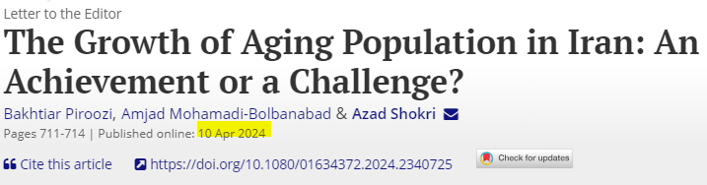
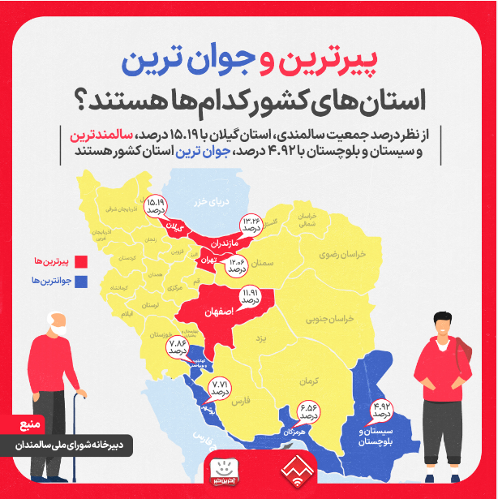

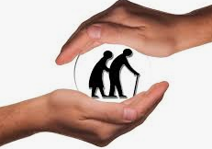
An Achievement or a Challenge?
Mean age: 32 yrs
Elderly rate:
  2016: 9/5% 2024: 11%
  Estimation: 2030: 15%
  Estimation: 2050: 30%
  doubling time 20y
  age 65 in 2024: 11%
https://www.tandfonline.com/doi/full/10.1080/01634372.2024.2340725

Slide 5
آینده پژوهی ساختار جمعیتی در ایثارگران (جانباز/شاهد) 2024
3میلون کل و 1میلیون شاهد و جانباز
در سال 1400: 25.5% جمعیت سالمند: (n=248,507)
سال 1410: 70.8 % جمعیت سالمند: چالش جدی 60-69 ساله ها
  (n=595,172) + 70 سال حدود15%
سال 1420: 81.5% جمعیت سالمند: چالش جدی 70 سال و بالاتر
  (n=580,365) + 70 سال حدود65%
  زنگ خطر "چالش فرصت یا بحران":
  آمادگی برای مواجه این شیفت جمعیتی چقدر است؟
  آیا زیرساخت های لازم برای ارایه خدمات مهیا است؟
؟
https://ijwph.ir/browse.php?a_id=1509&sid=1&slc_lang=en

Slide 6
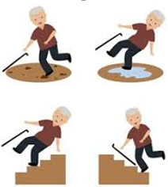
Definition of falls
Different interpretations of falls:
Falls are prominent among the external causes of unintentional injury.
Older people: “loss of balance”,
Health care professionals: “events leading to injuries and ill health”
WHO: Classification of Disease as W00-W19 in ICD-10: Falls are commonly defined as “inadvertently coming to rest on the ground, floor or other lower level, excluding intentional change in position to rest in furniture, wall or other objects”.
سقوط سالمندان به هر رویدادی اطلاق می‌شود که طی آن فرد سالمند ناخواسته به زمین یا سطح پایین‌تری می‌افتد.

Slide 7
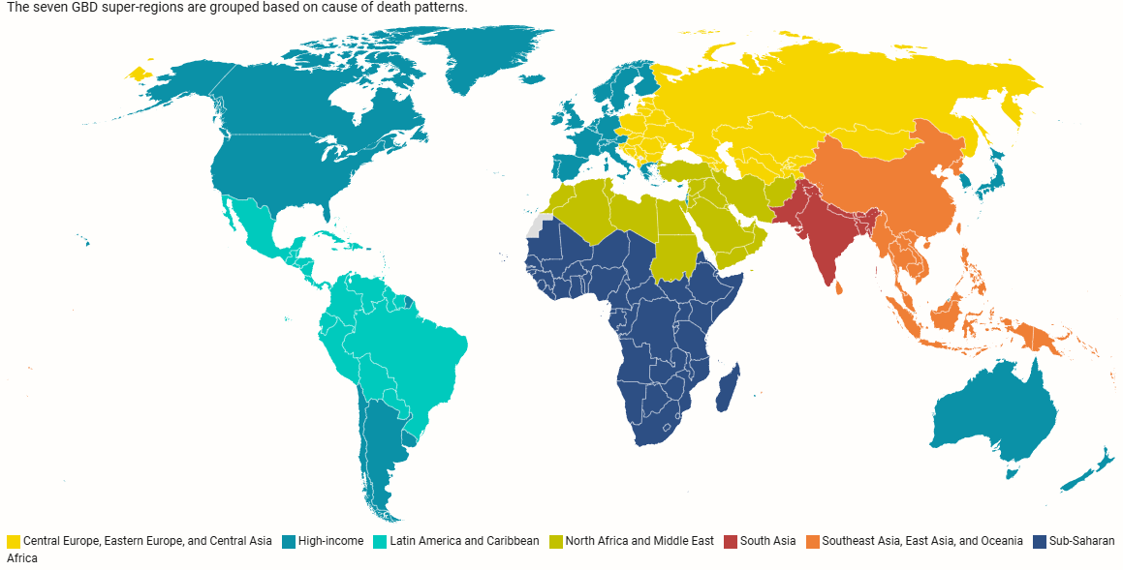
Global Burden of Disease-GBD
The single largest detailed scientific effort to quantify levels and trends in health Across places and time,
Data : hospitals, governments, surveys, and other databases around the world
Index: All‐cause mortality, deaths by cause, years of life lost due to premature mortality (YLLs), years lived with disability (YLDs), and disability‐adjusted life years (DALYs)
Health Metrics and Evaluation-University of Washington: over 12,000 researchers & in +160 countries update

Slide 8

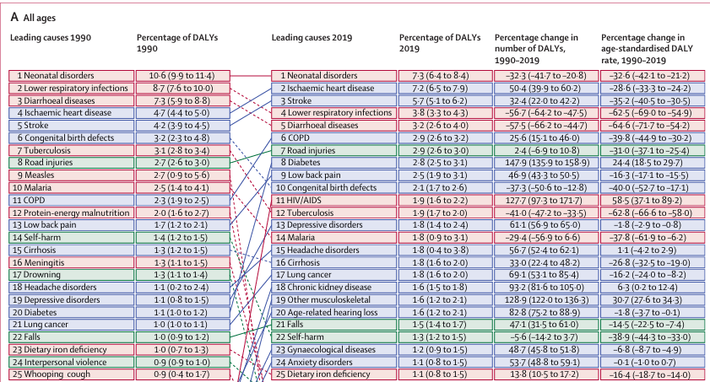
GBD:1990-2019 all age: fall in top 21

Slide 9
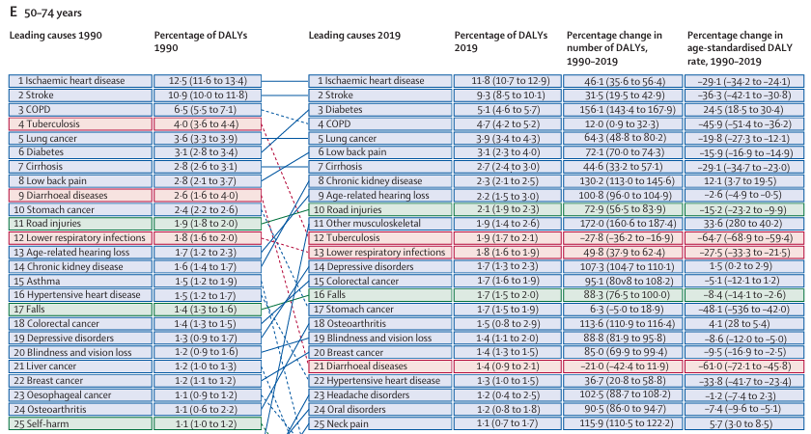
GBD:1990-2019 (age 50-74): fall in top 16
20 out 25 of GBD in elderly non-communicable diseases
Lancet 2020; 396: 1204–22. chrome-extension://efaidnbmnnnibpcajpcglclefindmkaj/https://www.thelancet.com/pdfs/journals/lancet/PIIS0140-6736(20)30925-9.pdf

Slide 10
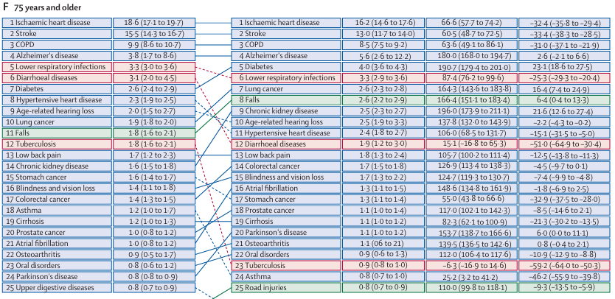
GBD:1990-2019 (age +75): fall in top 8
Lancet 2020; 396: 1204–22. chrome-extension://efaidnbmnnnibpcajpcglclefindmkaj/https://www.thelancet.com/pdfs/journals/lancet/PIIS0140-6736(20)30925-9.pdf

Slide 11
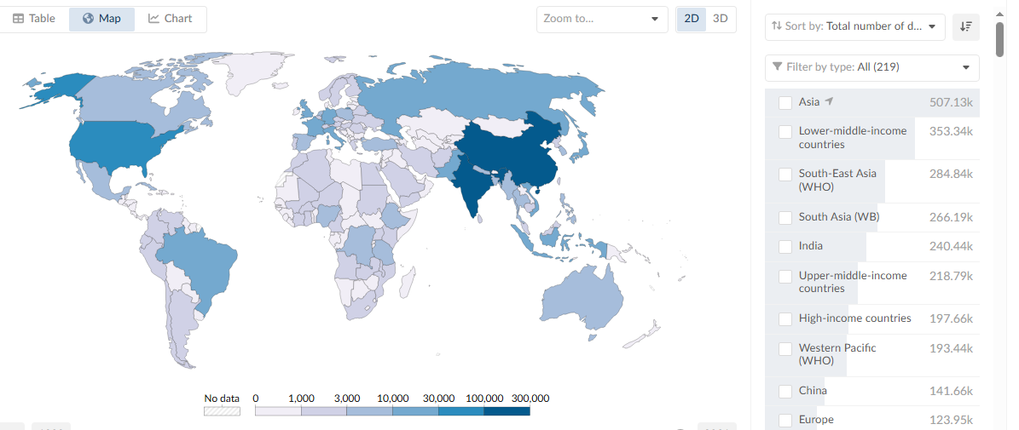
Deaths from falls - 2021
WHO: Injuries responsible for:
10% of global deaths and 16% of disabilities
https://ourworldindata.org/grapher/deaths-from-falls-gbd?time=2021

Slide 12
Facts About older adults Falls
25-35% age>65 falls each year, but less than half tell their doctor: restricted activity for at least 1 to few days- get around, daily activities, or live on their own.
32-42% for those over 70 years of age
%10 of falls results in an injury: need healthcare system with restrict activities
In 2019,
  88% of emergency department visits and hospitalizations for hip fractures
  83% percent of hip fracture deaths were caused by falls.
“Silent epidemic or older adults with TBI”: Falls are the leading cause of traumatic brain injuries TBI for older adults 51%.
Post fall syndrome: Falling once doubles the chances of falling again- even if they're not injured-… so….. person to cut down everyday activities……then….less active and so become weaker and ……… higher chances of falling.
https://www.cdc.gov/falls/data-research/facts-stats/index.html
https://pmc.ncbi.nlm.nih.gov/articles/PMC2367127/

Slide 13
Nursing home falls worldwide: 18 surveys
45% to 75% residents fall annually
50% of residents who experienced falls with injury have a form of dementia
24% Muscle weakness and gait problems, cannot walk on their own
81% of falls with injury occur in a resident’s own room
72% involve walkers or wheelchairs
50-70% happen when getting out of bed or getting up from a chair
Injury happen during mealtimes and afternoon/evening
10% falls result in serious injury
Reasons:
  Negligence: staff fail to supervise for hazards.
  Lack of supervision: not properly monitored or assisted when needed.
  Failure to follow safety protocols: proper staffing, supervision, and safety measures
https://pubmed.ncbi.nlm.nih.gov/37433427/

Slide 14
Hospital falls worldwide: 43 surveys
  Falls rates, which are usually expressed per 1,000 bed days:
    2 to 8 in acute hospitals, geriatric wards and emergency
  25-30% lead to injuries
    15%Minor injuries(lacerations, contusions, sprains and strains)
    10% serious injuries(head injuries, fractures and death)
    4% deaths
Significant falls reduction in hospitals is patient education and
  health professional education but not bed /chair alarms, or sensors.
2022 https://academic.oup.com/ageing/article/51/5/afac077/6581612

Slide 15
Iran: 2025 published
2021 in Iran falls among older adults:
Incidence rate: 1674.0/100,000 (95% UI: 1454.9-1897.3),
Prevalence rate: 11302.5/100,000 (10504.7-12095.7), 11%
Death rate: 16.9 (12.9–21.0),
DALYs rate: was 736.3 (647.6-825.4)
Incidence rate of falls has increased significantly among older adults
Males had higher prevalence, death, and DALYs rates of falls compared to females
https://pmc.ncbi.nlm.nih.gov/articles/PMC12004857/

Slide 16
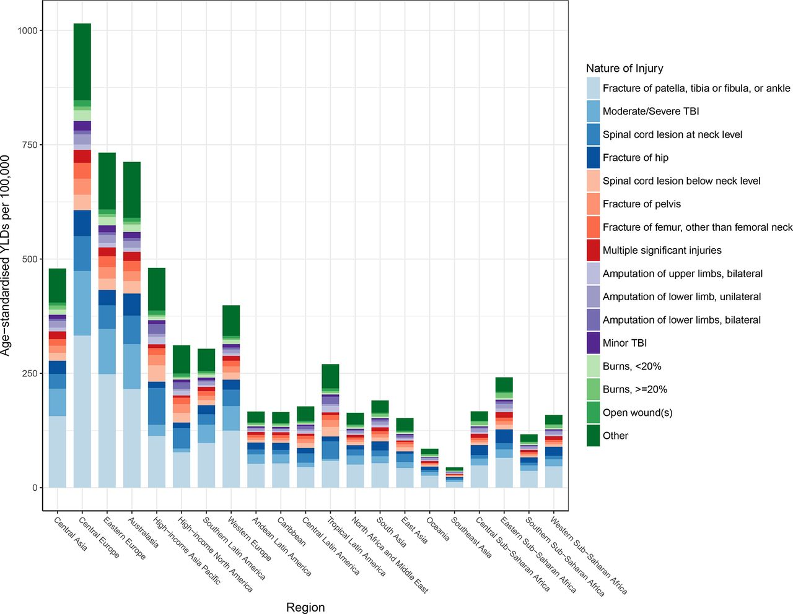
nature-of-injury composition of falls by region: BMJ 2020
nature-of-injury:
Fracture of patella, tibia or fibula, or ankle
Moderate TBI
https://injuryprevention.bmj.com/content/26/Suppl_2/i3

Slide 17
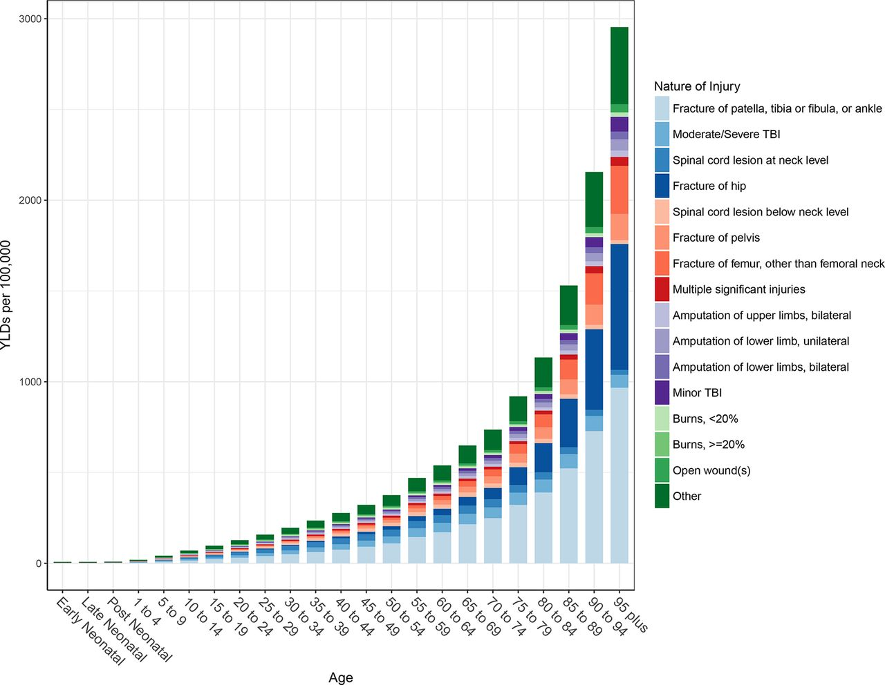
nature-of-injury composition of falls by AGE: BMJ 2020
Elderly fall burden trend:
Fracture of patella, tibia or fibula, or ankle
Fracture of hip
Fracture of femur, other than femoral neck
Fracture of pelvis
TBI
https://injuryprevention.bmj.com/content/26/Suppl_2/i3

Slide 18
The global burden of falls: BMJ
What is already known
  Every region of the world experiences health loss from falls.
  Falls have consistently been a leading cause of fatal and non-fatal health loss in the Global Burden of Disease Study (GBD).
What this study adds
  Decreased by 8.8% in the high socio-demographic index (SDI) but increased in the middle, low-middle income countries.
  Countries with the highest incidence of injuries from falls do not necessarily have the highest cause-specific mortality.
  For all 21 GBD regions, the most common nature of injury sustained by fall victims is fracture of patella, tibia or fibula, or ankle.
https://injuryprevention.bmj.com/content/26/Suppl_2/i3

Slide 19
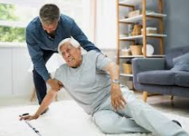
The burden of falls keys:
Economic costs
  healthcare expenses
  Ambulance services, hospitals & aged care providers
  Lost income individuals and their carers
Loss of independence & reduced mobility
Families pressure
Decline in quality of life
Community and social activities limitation
Emotional distress, leading to isolation
Preventable

Slide 20
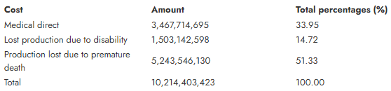
economic impact of falls among older adults
DIRECT COST : 2021 USA
  Average treat-and-release emergency room visit after an older adult fell unintentionally cost $8,869
  The average hospitalization after a fall cost $53,889
IRAN: 2019
  The average direct medical cost of each trauma patient was about $226.
https://beat.sums.ac.ir/article_50137.html

Slide 21
What has changed? 2025
The 2025 Falls Guidelines recommends a greater focus on evidence-based fall prevention interventions for an older person’s level and type of risk and less emphasis on assigning a numerical fall risk score.
Focus on fall prevention interventions

Slide 22
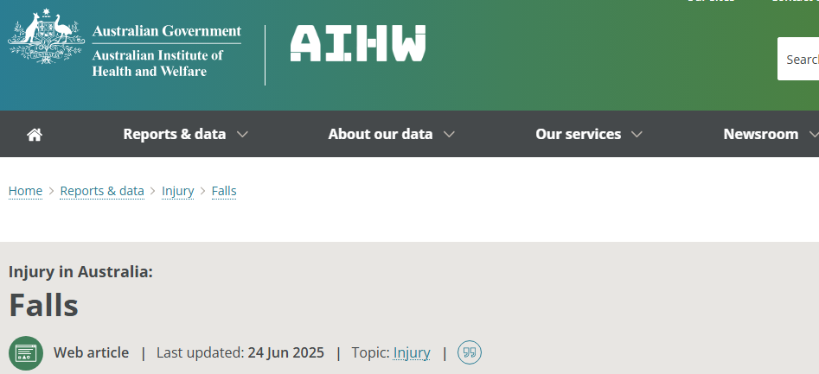
https://www.aihw.gov.au/reports/injury/falls

Slide 23
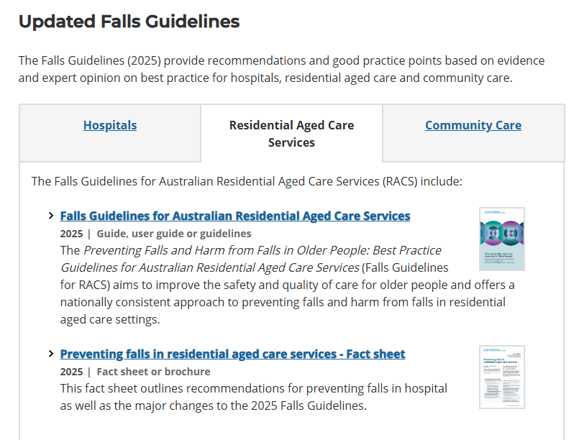
Australia 2025
https://www.safetyandquality.gov.au/our-work/falls-prevention

Slide 24
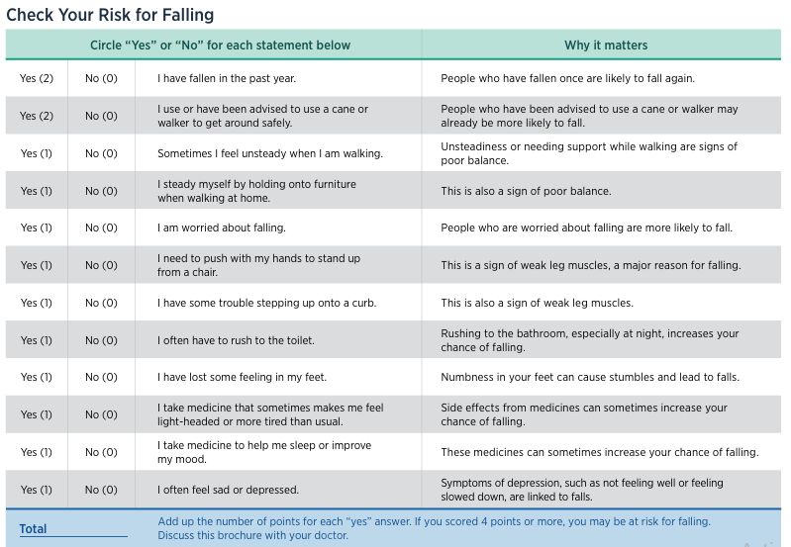
To check your risk online, visit: www.bit.ly/3o4RiW8
This checklist was developed by the Greater Los Angeles VA Geriatric Research Education Clinical Center and affiliates and is a validated fall risk self-assessment tool (Rubenstein et al. J Safety Res; 2011: 42(6)493-499). Adapted with permission of the authors.

Slide 25
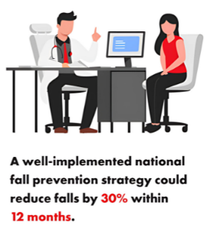
fall approach in Older Adults
Role of general medical doctor in:
Prevention
Screening
Education
Fall Prevention is the key
&
A critical public health priority

Slide 26
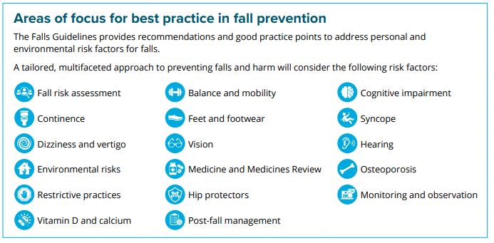
https://www.safetyandquality.gov.au 2025

Slide 27
Prevention Strategies
  Role of general medical doctor in:
  Primordial Prevention
  Risk factor reduction (through laws and national policy).
  Underlying disease (physical activity;, etc.)
  Primary Prevention
  Prevent a disease from ever occurring. (limit risk exposure or increase the immunity by immunizations
  Secondary Prevention
  Early disease detection: Secondary prevention often occurs in the form of screenings.
  Tertiary Prevention
  Tertiary prevention targets symptomatic patients and aims to reduce the severity of the disease as well as any associated sequelae.
  Quaternary Prevention
  Action taken to identify patients at risk of overmedicalization, to protect him from new medical invasion, and to suggest to him interventions, which are ethically acceptable. "an action taken to protect individuals (persons/patients) from medical interventions that are likely to cause more harm than good."

Slide 28
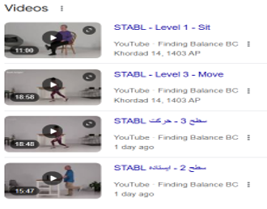
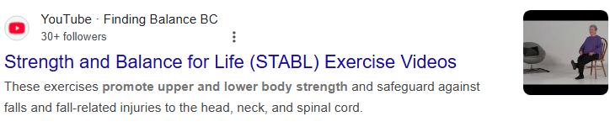
balance training for older adults
take massage home:
prevention
https://www.youtube.com/playlist?list=PLQAZ8cBTWL3G0HqDNUKLHSY9Vk8mzz_dm

Slide 29
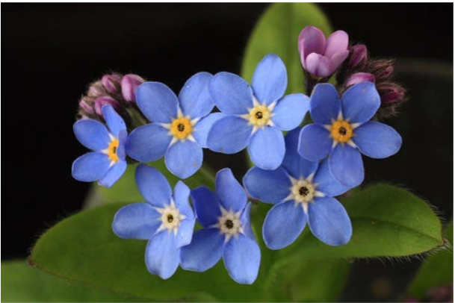
Symbol of true love and respect
The official flower of National Grandparents' Day is the forget-me-not, which blooms in the spring, small blue flowers that grow anywhere from 4 to 12 inches.
Represents remembrance and long-associated with dementia. People with dementia may experience memory loss, among other symptoms. This makes the forget-me-not the perfect flower to represent our cause.

